Slide 1
266 Natural Language Processing
Week 5: Text Generation Models

Slide 2
This Week
Goals
Understand large scale auto-regressive language models
Understand the sequence to sequence architecture

Slide 3
Peeking Ahead
Week 1: Introduction
Week 2: Text Classification
Week 3: Language and Context
Week 4: Pretrained Transformers
Week 5: Text Generation Models
Week 6: Machine Translation ●PROJECT PROPOSAL DUE Feb 18
Week 7: Question Answering & Summarization
Week 8: Linguistic Representation
Week 9: Entities and Linking
Week 10: Embedding-based Retrieval
Week 11: Multimodality in NLP
Week 12: ML Fairness and Privacy
Week 13: NLP in the Real World

Slide 4
Announcements
Assignment 2 (Classification) - released this past Friday 01/26
Due Sunday, 02/11 (Tuesday 02/13 if you use late days)
Please come to an office hour if you are having difficulty with it
Assignment 3 (QA) to be released Friday 02/16.
Project Proposals - Due 02/18!
Questions?
Concerns?

Slide 5
Announcements
Paper reading sessions:
Solving olympiad geometry without human demonstrations
AlphaCode 2
Peter: Tuesday 02/06 12:00 pm PST
Notebook Walkthroughs:
The Math behind Back Propagation
James: Tuesday 02/13 6:30 pm PST
Concerns?

Slide 6
Feedback Please!
Mid-term feedback is open!
https://course-evaluations.berkeley.edu
We are always working on changes to improve the class. If you have ideas, please feel free to *also* reach out if your ideas don’t fit the feedback template.

Slide 7
The Plan
Structure of Class
Key Learning Review
Sequences
Specific Models
T5
GPT
InstructGPT/ChatGPT

Slide 8
Key Learnings Review
Text Generation Models

Slide 9

The Transformer Architecture
Image Source:http://jalammar.github.io/illustrated-transformer/

Slide 10
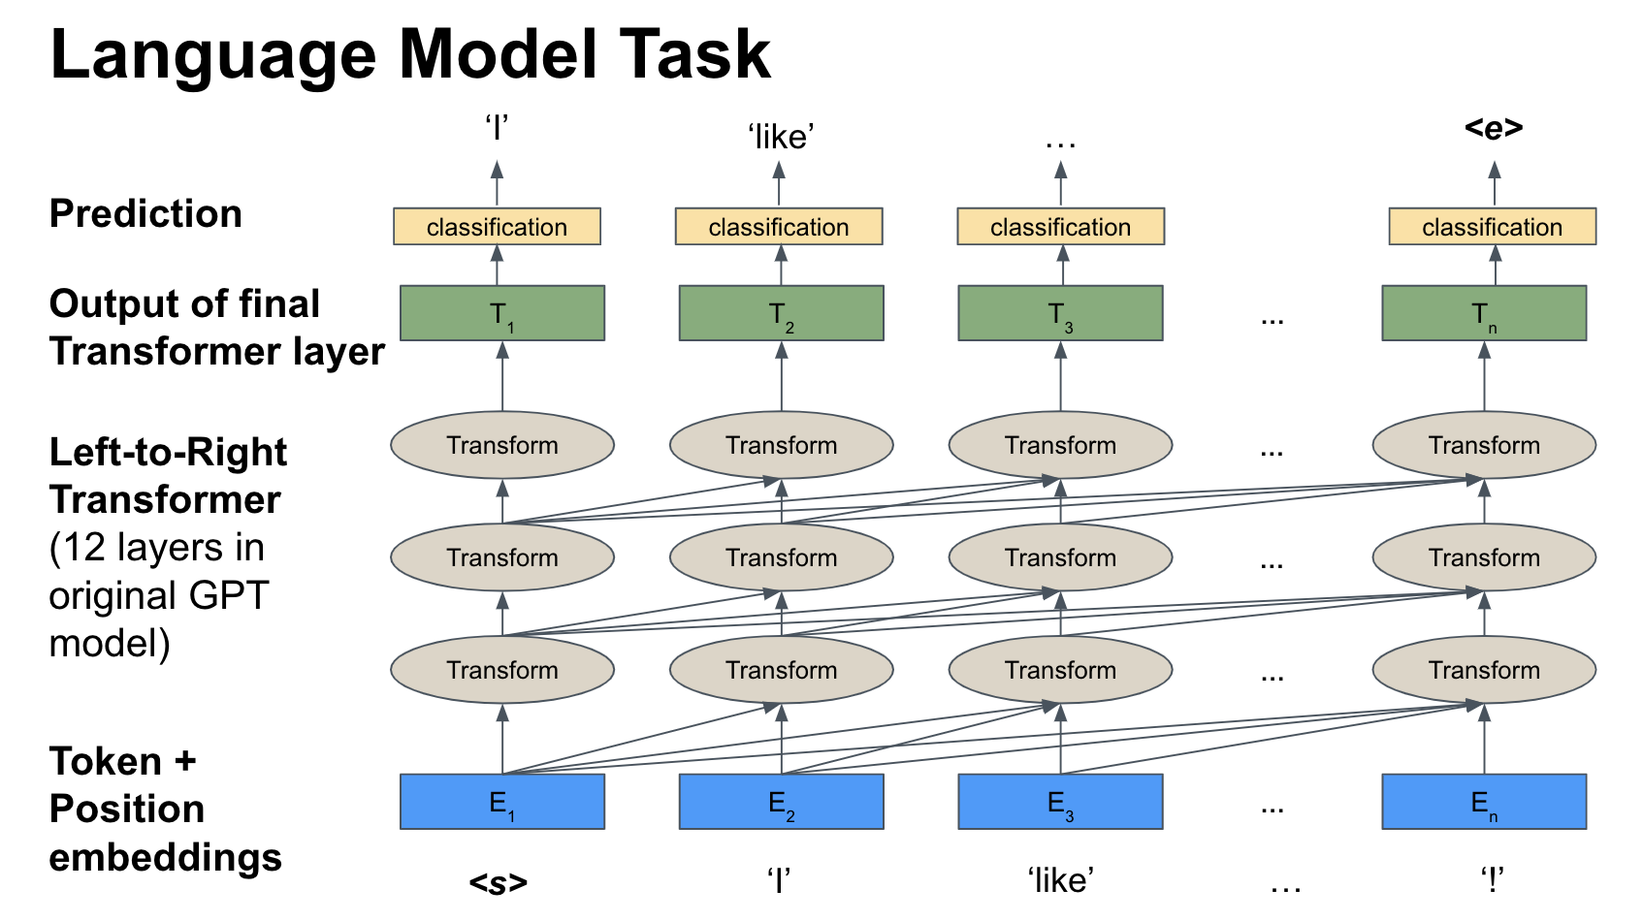
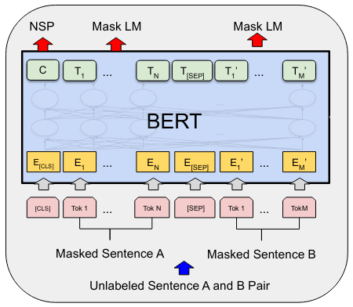
GPT Structure vs. BERT
Image Source (edited): Devlin et al., BERT: Pre-training of Deep Bidirectional Transformers for Language Understanding, https://arxiv.org/pdf/1810.04805.pdf
Questions:
What are the differences between both models?
How does that relate to the training tasks?
Notes:
The fat cat sat on the fence and meowed.
The fat cat sat on the → fence
https://openai.com/blog/better-language-models/#sample5

Slide 11
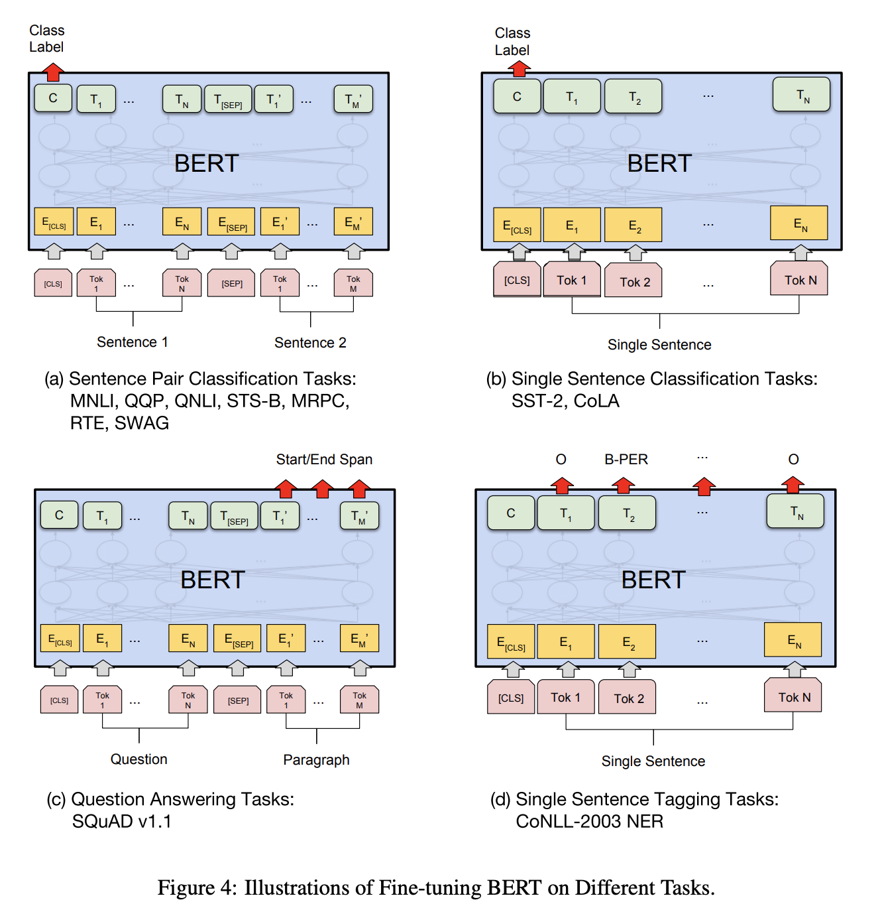
BERT & Downstream Tasks
Questions:
What is going on here?
Why should/does this work?
Why does this constitute big progress?
Source: Devlin et al., BERT: Pre-training of Deep Bidirectional Transformers for Language Understanding, https://arxiv.org/pdf/1810.04805.pdf
Notes:
Y = The fat cat sat on the fence and meowed
X = The __ cat sat on ___ fence and meowed

Slide 12
Async Review
Text Generation Models

Slide 13
NLP Review
Text Generation
What are some use cases?
What is conceptually different from what we did with BERT?
What are some of the approaches?

Slide 14
Sequences
Text Generation Models

Slide 15
Sequential Neural Models
Sequence Annotation Model
Sequence to Vector Model
Vector to Sequence Model
Encoder Decoder Model
aka Sequence 2 Sequence Model
Notes:
Sequence Annotation = tag each input (POS tagging)
Sequence to Vector = produce final output after all inputs (classification)
Vector to Sequence = produce outputs based on one input (image captioning)
Sequence to Sequence = read a sequence of inputs and encode a representation, use that representation to generate a new sequence (machine translation)
The fat cat sits on the fence
The → fat
The fat → cat
The fat cat → sits
The fat cat sits → on

Slide 16
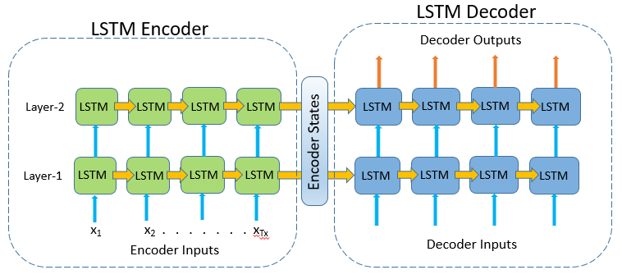
Encoder-Decoder using only LSTMs
https://towardsdatascience.com/text-summarization-from-scratch-using-encoder-decoder-network-with-attention-in-keras-5fa80d12710e
Notes:
Sequence Annotation = tag each input (POS tagging)
Sequence to Vector = produce final output after all inputs (classification)
Vector to Sequence = produce outputs based on one input (image captioning)
Sequence to Sequence = read a sequence of inputs and encode a representation, use that representation to generate a new sequence (machine translation)

Slide 17
Attention Idea: Looking Back!
the
blue
house
</s>
la
maison
bleue
</s>
<s>
the
blue
house
More specifically: “Using a vector d_{t} created in the Decoder at position/time t , and the set of e_{s} of Encoder outputs to create pointers to ‘where to look in the source text’ to inform generating the next translation token”

Slide 18
Text Generation using An RNN Seq2Seq Model With Attention
Questions:
What is the conditional probability that we model? (‘Predict x given y’... what are x and y?)
How is the context communicated to generate ‘das’ as the first word? Do we need both?
How would the training examples look like to train a translation model, i.e. what are the model inputs & outputs?
‘das’
Attention calculation
‘<s>’
‘this’
‘is’
‘good’
‘<e>’
‘<s>’
‘das’
Original idea (implemented slightly differently): “Neural Machine Translation by Jointly Learning to Align and Translate,” Bahdanau et al., 2014, https://arxiv.org/pdf/1409.0473.pdf

Slide 19
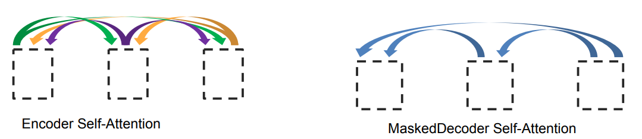
Attention is All You Need (Vaswani et al. 2017)
What if we replaced the entire RNN with self-attention?
Repeated self-attention layers for encoder
Decoder uses masked self-attention for sequential output
Sinusoidal timing signal to distinguish position
Graphic from Lukasz Kaiser: https://nlp.stanford.edu/seminar/details/lkaiser.pdf
Notes:
See https://research.googleblog.com/2017/08/transformer-novel-neural-network.html and Vaswani et al. 2017

Slide 20
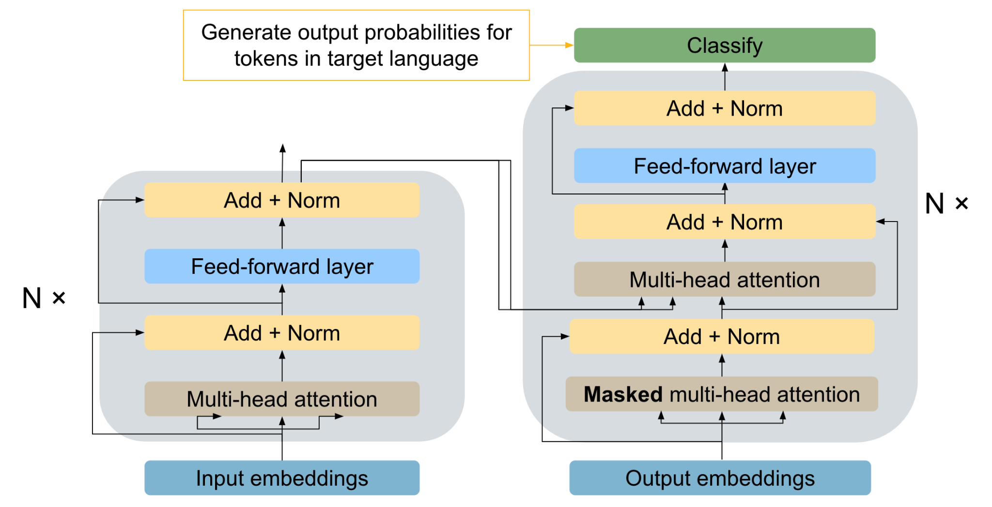
Text Generation using Transformers
Questions:
How is the context now communicated to generate the output tokens?
Why are there two attention calculations in the Decoder?
Notes:
What are Q, K, and V in the second attention calculation in the decoder?

Slide 21

The Transformer Architecture
Image Source:http://jalammar.github.io/illustrated-transformer/

Slide 22

The Transformer Architecture
Image Source:http://jalammar.github.io/illustrated-transformer/

Slide 23

The Transformer Architecture
Image Source: jalammer.github.io/illustrated-bert

Slide 24

Attention with Decoders
Image Source: jalammer.github.io/illustrated-bert

Slide 25
Specific Models: T5
Text Generation Models

Slide 26
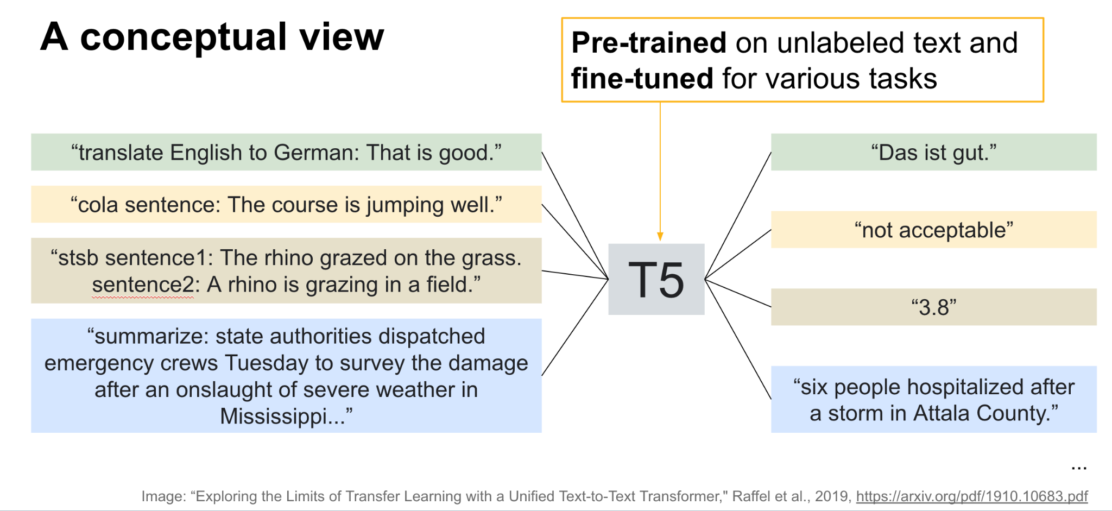
T5
Questions:
How is the pre-training done? What is the logic?
Why multiple tasks?
How do we operationalize a task? (Example: “This was fun!” → 1)

Slide 27
Paper Peeks
Exploring the Limits of Transfer Learning with a Unified Text-to-Text Transformer
Raffel et al. 2019

Slide 28
Specific Models: GPT-3
Text Generation Models

Slide 29
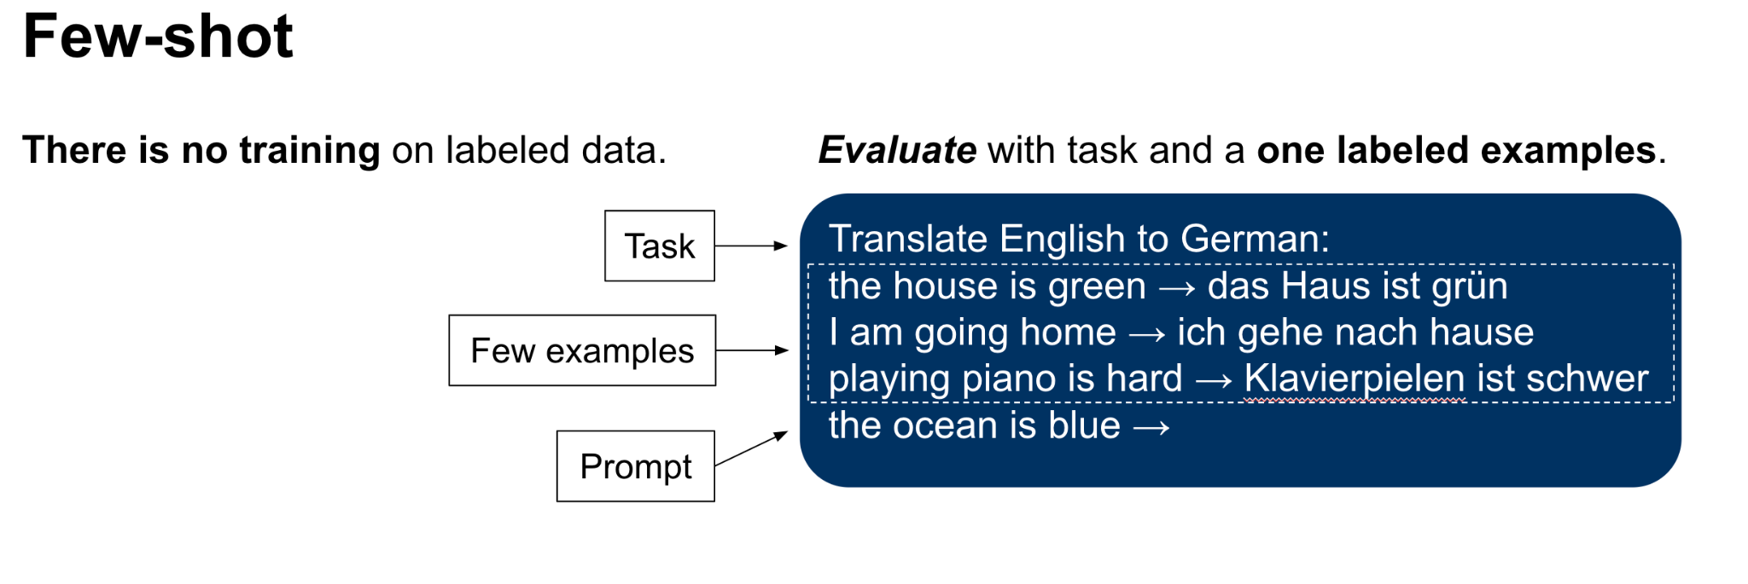
GPT-3
Questions:
What is the fundamental difference between GPT3 and models like T5?
Advantages? Disadvantages?
How did quality scale with model size?

Slide 30
Paper Peeks
Language Models are Few-Shot Learners
Brown et al. 2020

Slide 31
Notebook Walkthrough
Text Generation Models

Slide 32
Specific Models: InstructGPT/ChatGPT
Text Generation Models

Slide 33
ChatGPT based on InstructGPT
InstructGPT is built on versions of GPT3
Optimized to produce output “preferred” by human judges
Reinforcement Learning used to teach model to generate that output
1.3 billion parameter version of InstructGPT outperforms a 175 billion parameter version of GPT3
Source: Ouyang et al., Training Language Models to Follow Instructions with Human Feedback, https://arxiv.org/pdf/2203.02155.pdf

Slide 34
Reinforcement Learning
A program (agent) makes observations of its environment and takes actions based on a policy. Reinforcement learning rewards the agent/policy for taking “good” actions.
In InstructGPT:
The policy is the language model that takes input and predicts a probability distribution of next word.
Based on observing inputs, the policy provides a probability distribution over actions (next token).
The reward model assigns a score to the output which is used to update the policy.

Slide 35
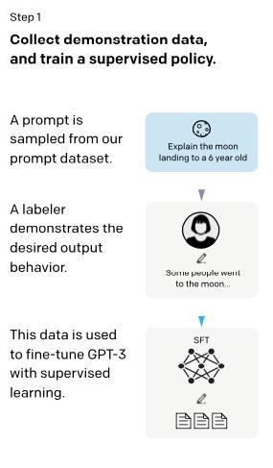
Improving GPT3 Output = ChatGPT
InstructGPT is trained to produce “better” output through three step process:
Step 1:
Get humans to write the ideal output for a given set of prompts.
Fine-tune GPT3 model on those human prompt/response pairs
Source: Ouyang et al., Training Language Models to Follow Instructions with Human Feedback, https://arxiv.org/pdf/2203.02155.pdf

Slide 36
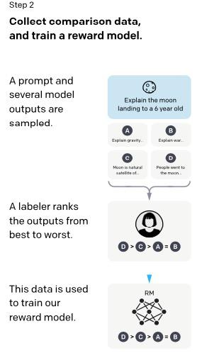
Improving GPT3 Output = ChatGPT
Step 2:
Have humans rank outputs from fine-tuned model
Use this labeled/ranked data to train a reward model
A reward model assigns a scalar score to each input text. The score mimics human preference.
Source: Ouyang et al., Training Language Models to Follow Instructions with Human Feedback, https://arxiv.org/pdf/2203.02155.pdf

Slide 37
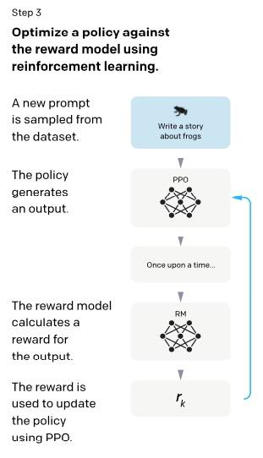
Improving GPT3 Output = ChatGPT
Step 3:
Generate multiple outputs from new prompt.
Use reward model to score new outputs.
Policy is changed based on rewards.
Repeat continuously
Source: Ouyang et al., Training Language Models to Follow Instructions with Human Feedback, https://arxiv.org/pdf/2203.02155.pdf

Slide 38
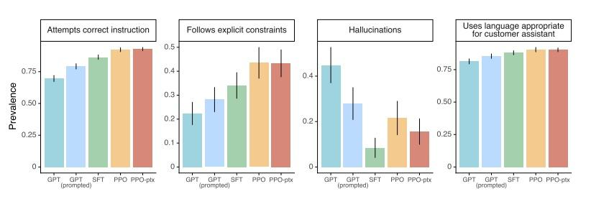
InstructGPT outperforms GPT3
InstructGPT (yellow/brown) outperforms GPT3 (blue) on multiple dimensions
Source: Ouyang et al., Training Language Models to Follow Instructions with Human Feedback, https://arxiv.org/pdf/2203.02155.pdf

Slide 39
Notebook Walkthrough
Text Generation Models

Slide 40
Paper Peeks/Recent Advances/Challenges
Text Generation Models

Slide 41
Papers
Challenges and Applications of Large Language Models

Slide 42
Extras
Text Generation Models

Slide 43
What if we only used attention?
The first slide illustrates the concept of the attention layer as used between the RNN based encoder and decoder. The second slide introduces the basic concept behind “Attention Is All You Need”. It was an encoder-decoder model used for machine translation that introduced the transformer architecture.

Slide 44
Attention Idea: Looking Back!
the
blue
house
</s>
la
maison
bleue
</s>
<s>
the
blue
house
More specifically: “Using a vector d_{t} created in the Decoder at position/time t , and the set of e_{s} of Encoder outputs to create pointers to ‘where to look in the source text’ to inform generating the next translation token”

Slide 45
Attention is All You Need (Vaswani et al. 2017)
What if we replaced the entire RNN with self-attention?
Repeated self-attention layers for encoder
Decoder uses masked self-attention for sequential output
Sinusoidal timing signal to distinguish position
Graphic from Lukasz Kaiser: https://nlp.stanford.edu/seminar/details/lkaiser.pdf
Notes:
See https://research.googleblog.com/2017/08/transformer-novel-neural-network.html and Vaswani et al. 2017

Slide 46
Full Transformer Architecture
These slides break down the full architecture of the original transformer model from the paper “Attention Is All You Need”. It was an encoder-decoder model used for machine translation.
The simplest transformers we talked about last week only use one half of the encoder-decoder setup (BERT is just an encoder, GPT is just a decoder). This week we focus on encoder-decoder models and decoder only models for text generation.

Slide 47

Full Transformer
Image Source:http://jalammar.github.io/illustrated-transformer/

Slide 48

Full Transformer
Image Source:http://jalammar.github.io/illustrated-transformer/

Slide 49
MT Attention Demo
-> go here

Slide 50
Appendix

Slide 51
Fine-Tuning vs Multi-shot Learning
These slides illustrate fine-tuning and one to few shot prompting.

Slide 52
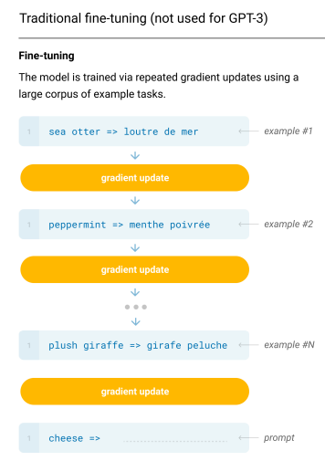
Traditional Fine-tuning
Use loss and back propagation to modify the weights in the model to better predict based on training samples
Each fine-tuned model has its own unique set of weights

Slide 53
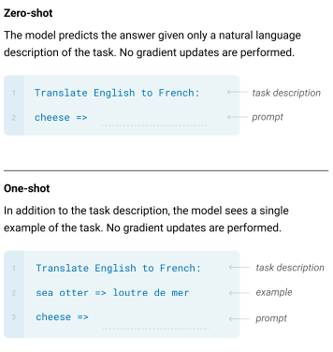
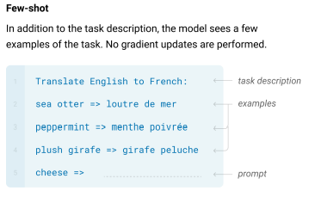
Zero-, one- and few- shot learning

Slide 54
Instruction Fine-Tuned LMs and Generalization
These slides discuss Instruction Fine Tuning which is shown to substantially increase the performance of language models as seen in the paper “OPT-IML : Scaling Language Model Instruction Meta Learning through the Lens of Generalization”. It uses a fine-tuned OPT model that is trained to produce outputs that follow instructions on a wide variety of tasks without reinforcement learning. Instruction Fine-Tuning is also responsible for performance improvements in FLAN-T5 and FLAN-PaLM.

Slide 55
Generalization
How can we train an LLM to be good at everything?
Combine datasets!
From GLUE - 10 NLP tasks
To the FLAN 2022 - over 1,800 NLP tasks
Large data sets allow for massive scaling and improved results.

Slide 56
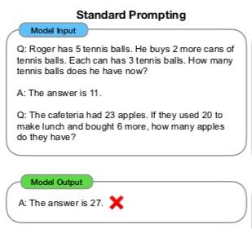
From Standard Prompting…
Provide the model with a few examples of the task:
Few Shot
One Shot
The model generalizes from the input examples to answer the question
Source: Chain-of-Thought Prompting Elicits Reasoning in Large Language Models

Slide 57
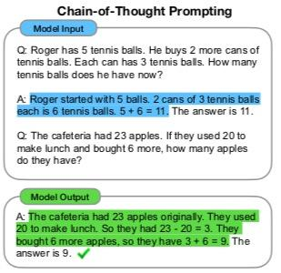
…To Chain of Thought Prompting
Don’t just prompt for the answer
Include intermediate steps
Ask/Fine-tune model to provide step by step output
Source: Chain-of-Thought Prompting Elicits Reasoning in Large Language Models

Slide 58
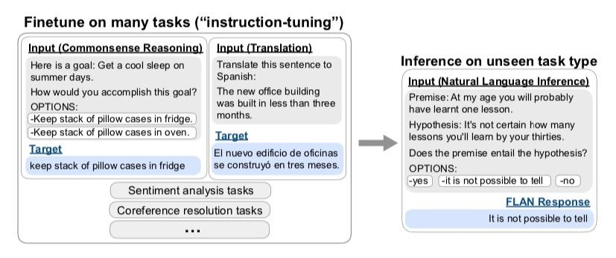
Instruction Fine-tuning
Test
Train
Source: Finetuned Language Models are Zero-Shot Learners

Slide 59
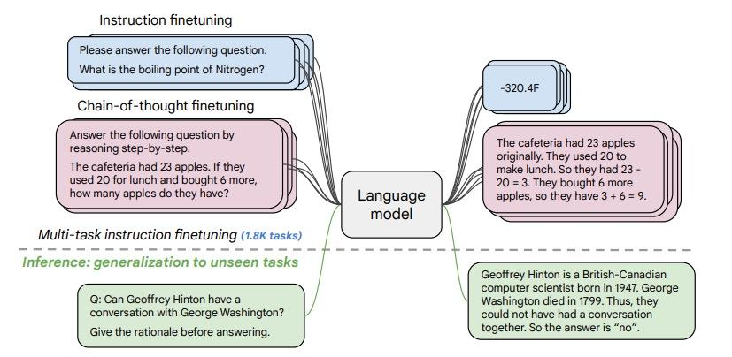
Instruction AND CoT Fine-Tuning
Source: Scaling Instruction-Finetuned Language Models

Slide 60
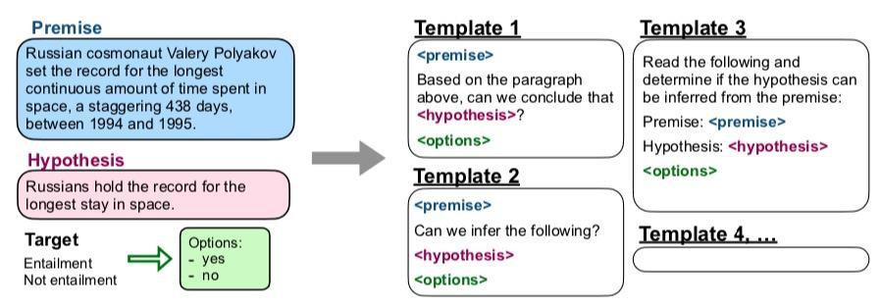
Create Instruction based fine tuning data
Programmatically generate data variants using templates!
Source: Finetuned Language Models are Zero-Shot Learners

Slide 61
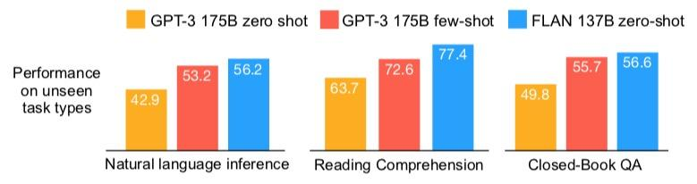
Instruction Fine-tuning Boosts Performance
Smaller FLAN model exceeds GPT-3 at zero-shot
Instruction Fine-Tuning is a possible alternative to RL
Instruction Fine-Tuned Alpaca-7B performs as well as GPT3.5 (text-davinci-003)
Source: Finetuned Language Models are Zero-Shot Learners

Slide 62
Instruction Fine-Tuning Papers
Super-NaturalInstructions: Generalization via Declarative Instructions on 1600+ NLP Tasks
Fine-tuned Language Models are Zero-Shot Learners
MULTITASK PROMPTED TRAINING ENABLES ZERO-SHOT TASK GENERALIZATION
OPT-IML : Scaling Language Model Instruction Meta Learning through the Lens of Generalization
Scaling Instruction-Finetuned Language Models
The Flan Collection: Designing Data and Methods for Effective Instruction Tuning

Slide 63
LLM Evaluation
Text Generation Models

Slide 64
Evaluation Datasets
MMLU
Big Bench
A curated list tracking advances in LLM evaluation

Slide 65
Reinforcement Learning from Human Feedback (RLHF)
Text Generation Models

Slide 66
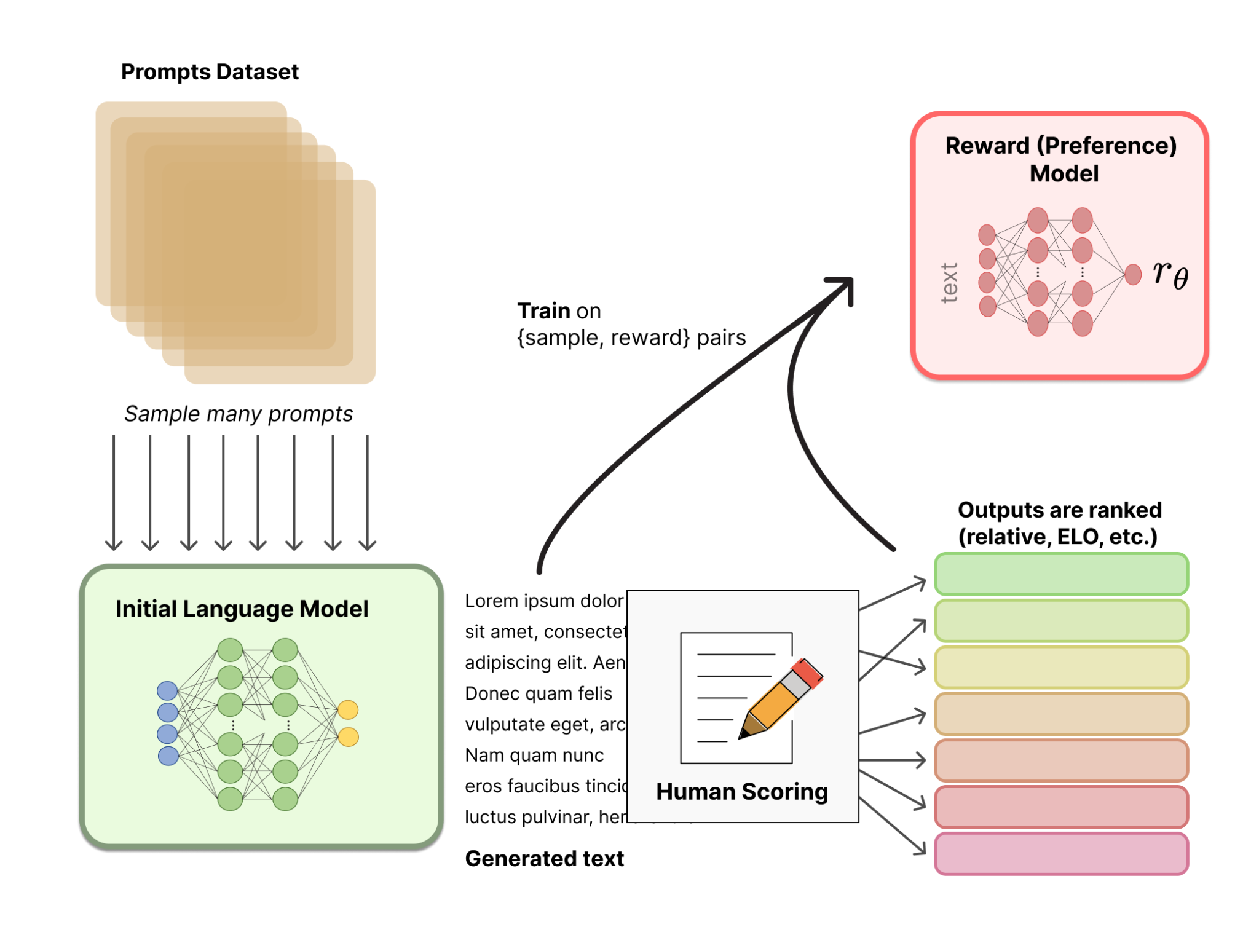
RLHF: Reward Model Training
Typically a (classifier) LLM*
https://huggingface.co/blog/rlhf

Slide 67
RLHF: Reward Model Training
Typically a (classifier) LLM*
* Literature is very unsettled on relative size of Reward model to pretrain (OpenAI >> smaller, DeepMind ~ the same size…)
https://huggingface.co/blog/rlhf

Slide 68
RLHF: Reward Model Training
Typically a (classifier) LLM*
* Literature is very unsettled on relative size of Reward model to pretrain (OpenAI >> smaller, DeepMind ~ the same size…)
https://huggingface.co/blog/rlhf

Slide 69
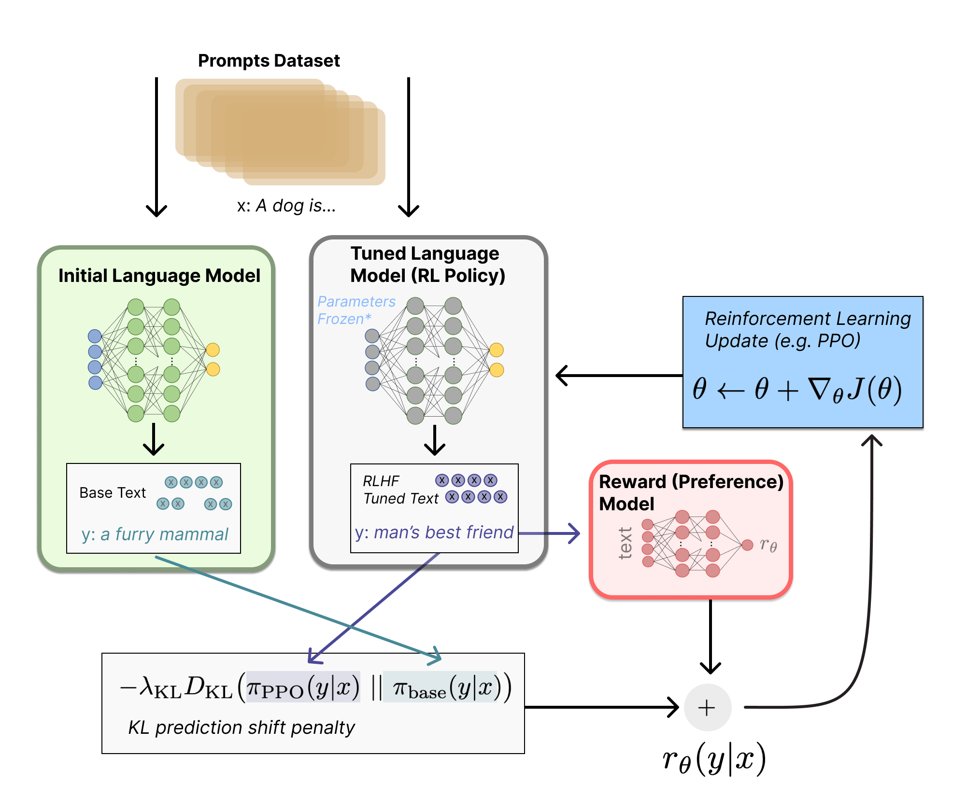
RLHF: Full RL Setup (InstructGPT)
=r_{RM}−λr_{KL}
​
https://huggingface.co/blog/rlhf

Slide 70
RLHF: Full RL Setup (InstructGPT)
RL framework
𝝅_{𝜭} = Tuned LLM
A = Vocabulary
S = Input text (prompts)
r_{𝜭}(y|x) =r_{RM}−λr_{KL}
=r_{RM}−λr_{KL}
​
https://huggingface.co/blog/rlhf

Slide 71
RLHF: Full RL Setup (InstructGPT)
RL framework
𝝅_{𝜭} = Tuned LLM
A = Vocabulary
S = Input text (prompts)
r_{𝜭}(y|x) =r_{RM}−λr_{KL}
Proximal Policy Optimization (PPO) penalization term so Tuned LLM does not “game” the Reward Model
=r_{RM}−λr_{KL}
​
https://huggingface.co/blog/rlhf

